Slide 1
Listing factors
TASK A : Systematic approach to find factor pairs
List the factor pairs of these numbers.
18
b) 28
c) 36
d) 32
e) 100
f) 67
1 × 18
2 × 9
3 × 6
1 × 28
2 × 14
4 × 7
1 × 36
2 × 18
3 × 12
4 × 9
1 × 32
2 × 16
4 × 8
1 × 100
2 × 50
4 × 25
5 × 20
1 × 67
2) Sam makes two rectangles with an area of 10 cm².
Explain how these rectangles show all of the factors of 10.
Because you cannot make a rectangle with a height of 3, 4, 6, 7, 8, or 9.
So 1 & 10 and 2 & 5 are the only factor pairs.

Slide 2





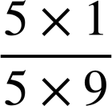

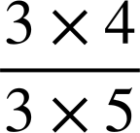

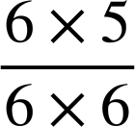

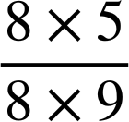

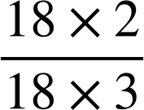


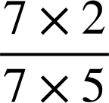





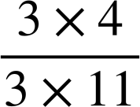

Listing factors
TASK B : Common factors
Use the Venn diagram to fill in the gaps.
45 has 2 factors which are not common with 60.
60 has 6 factors which are not common with 45.
45 and 60 have 4 common factors.
The common factors of 45 and 60 are 1, 3, 5 and 15.
Factors of 45
Factors of 60
9
4
1
3
60
2
45
5
15
20
30
12
2) Find the common factors for each of these following pairs of numbers:
a) 24 & 36
b) 24 & 38
c) 24 & 40
d) 24 & 72
1 × 24
2 × 12
3 × 8
4 × 6
1 × 36
2 × 18
3 × 12
4 × 9
6 × 6
1 × 24
2 × 12
3 × 8
4 × 6
1 × 38
2 × 19
1 × 24
2 × 12
3 × 8
4 × 6
1 × 40
2 × 20
4 × 10
5 × 8
1 × 24
2 × 12
3 × 8
4 × 6
1 × 72
2 × 36
3 × 24
4 × 18
6 × 12
8 × 9
TASK C : Simplifying fractions
Simplify fully the following fractions.
Try to use the highest common denominator.
a)
b)
c)
d)
e)
=
=
=
=
=
2) a) Which of the following are not in their simplest form?
b) Simplify those you have identified.
=
=
Mathematics in Education and Industry
v2.2

